Slide 1
RAP to sync Word documents with Quarto/ Rmarkdown reports Process: Annabel Westermann, July 2023 Slides adapted for Coffee and Coding, Georgina Anderson, February 2024

Slide 2
Lessons Learnt – a problem to solve
Musculoskeletal health: trends, risk factors and disparities in England, November 2022
One of the lessons learnt from producing this report was that the generation and inclusion of the narrative into the report had been a labour intensive and high risk task:
Many copies of a Word document being emailed around
No process for transcribing from Word document into Markdown syntax within the RAP
No version control
Very easy to inadvertently include old versions of the narrative in the final report meant lots of labour intensive QA required, especially approaching release date with lots of small changes being implemented.

Slide 3
Requirements met by this solution
Requirement | Met?
Minimise use of non-standard software | P
Avoid software not routinely available via AVD | P
Ability to track text amendments and for a separate contributor to accept/reject changes | P
Ability to add comments to specific text chunks and to track comment conversations | P
Version-control (date, author, text) with ability to revert changes at least up to the point of acceptance, ideally beyond | P*
Ability to view the report in its current state (eg charts and tables) whilst editing/reviewing narrative | O**
Process to be at least as efficient as current method of using MS Word and emails outside of report production process | P
* Version control is in Word not Git so separate from version control of code
** latest report can be viewed in a separate file alongside but charts won't be visible in the text document

Slide 4
Project Roles
Editor
Responsible for writing the report narrative
Needs developer to share visuals to be able to do this
May not have technical skills (R, Markdown, Quarto, Git)
[OHID: May not have access to AVD]
Developer
Responsible for sourcing and munging data, and creating visuals
Needs editor to specify report content to be able to do this
Experienced with technical software for RAP (R, Markdown, Quarto, Git)
[OHID: May need to access data on AVD]

Slide 5
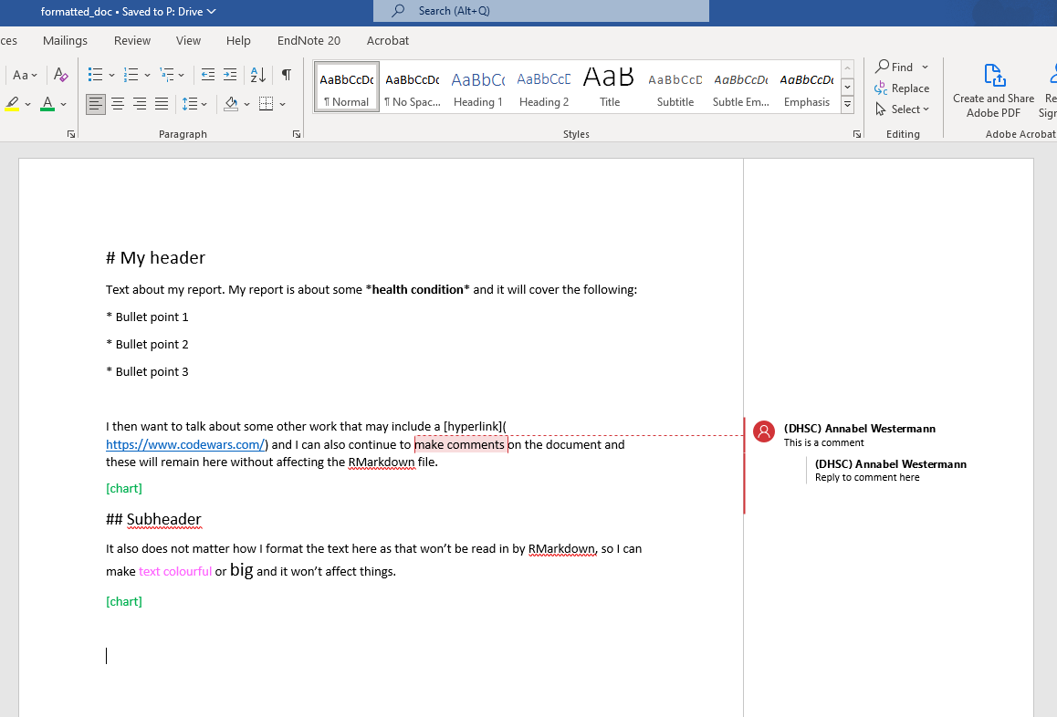
Editor SOP
Create Word document on shared drive
Write the report in Word using RMarkdown syntax
Make comments and reply to comments – can also style the Word document to make it easier to read as long as the RMarkdown syntax is correct
Write a placeholder Chart! to tell the code where to put charts
This Word doc gets automatically read in to R to create HTML report with correct formatting, so developers can focus on data/ charts and not copy and pasting and formatting text

Slide 6
Basic Markdown Syntax
Emphasis
*italic* **bold**
Headers
# Header 1
## Header 2
### Header 3
Links
[example text](www.google.com)
Unordered list
* Item 1
* Item 2
+ Item 2a
+ Item 2b
Ordered list
1. Item 1
+ Item 1a
+ Item 1a
2. Item 2

Slide 7
Developer SOP

Slide 8
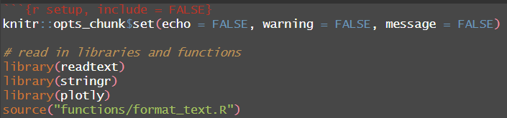
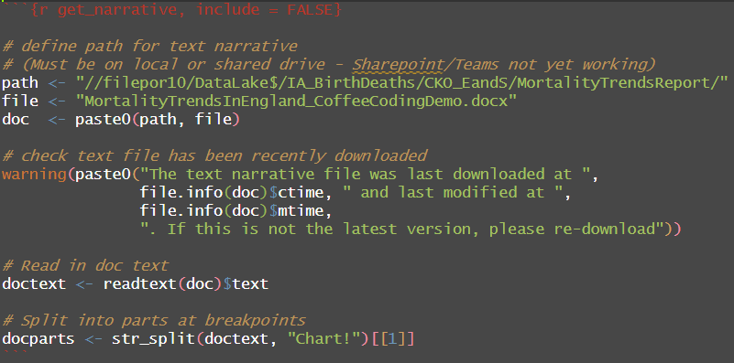
Read in and prepare text
Load libraries
Read in Word document
Split document text into parts at the chosen marker word, i.e. ‘Chart!’

Slide 9
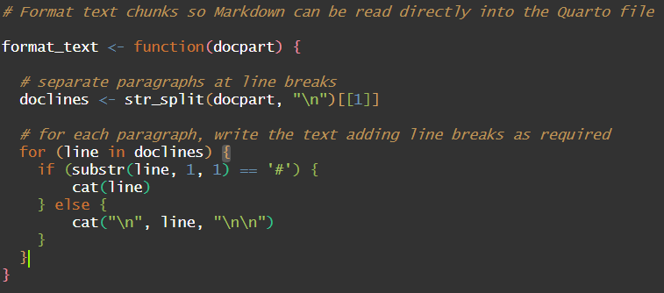
Create function to format text chunks
Use this format_text function to remove extra space (‘\n’) given by Word and also add the correct space after a header so that it will be formatted properly in RMarkdown

Slide 10
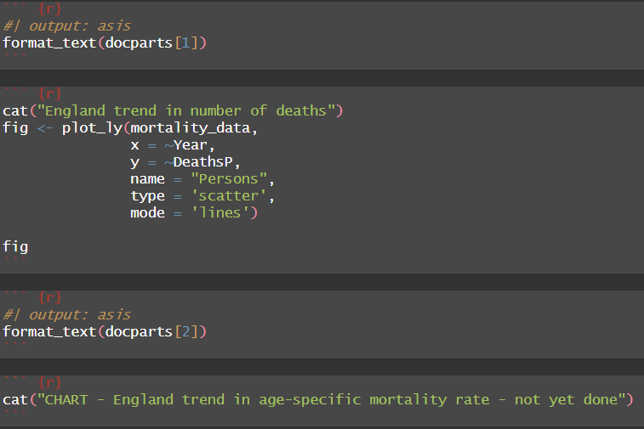
Insert text and charts alternately in Quarto file
5. Insert first text chunk using format_text function. Set output execution option to ‘asis’ so that the results will be read as Markdown content not a code block
6. Afterwards, insert first plot
7. Then insert second text chunk
8. Then insert second chart (or placeholder in this case as WIP)

Slide 11
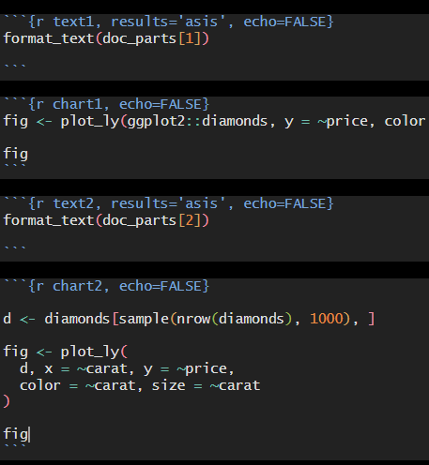
Alternative syntax if using RMarkdown instead of Quarto
5. Insert first text chunk using format_text function. Set results execution option to ‘asis’ so that the results will be read as Markdown content not a code block
6. Afterwards, insert first plot
7. Then insert second text chunk
8. Then insert second chart

Slide 12
Unresolved issues
If using track changes in the word document – All text will be read in (not just latest suggestions) so ideally need to accept/reject all tracked changed before reading the document in.
No resolution yet for reading document in from Sharepoint or Teams workspace as this requires credentials. Microsoft365 R package may provide this functionality.
Confusing using numbering for text chunks, especially if order changes. Can enhance code to name the text chunks so easier to cross reference between Word and Quarto.
Difficult to sync charts back to the original Word document for further review:
Explored this approach and did get it to work with Python but not Plotly R
Complicated Python code – difficult to maintain
Only possible to export static chart images to Word anyway, not interactive graphs
Instead, export most recent HTML report to same folder as Word document and the editor can view alongside

